Slide 1
Example: Echonet Washing Machine
Andreas Sayegh, Deutsche Telekom
Intended for: SHTF
Dec 9, 2014

Slide 2
Purpose of this contribution
Show another example to use the SDT
Change 2015-01-06:
Included documentation in SDT translation as discussed

Slide 3
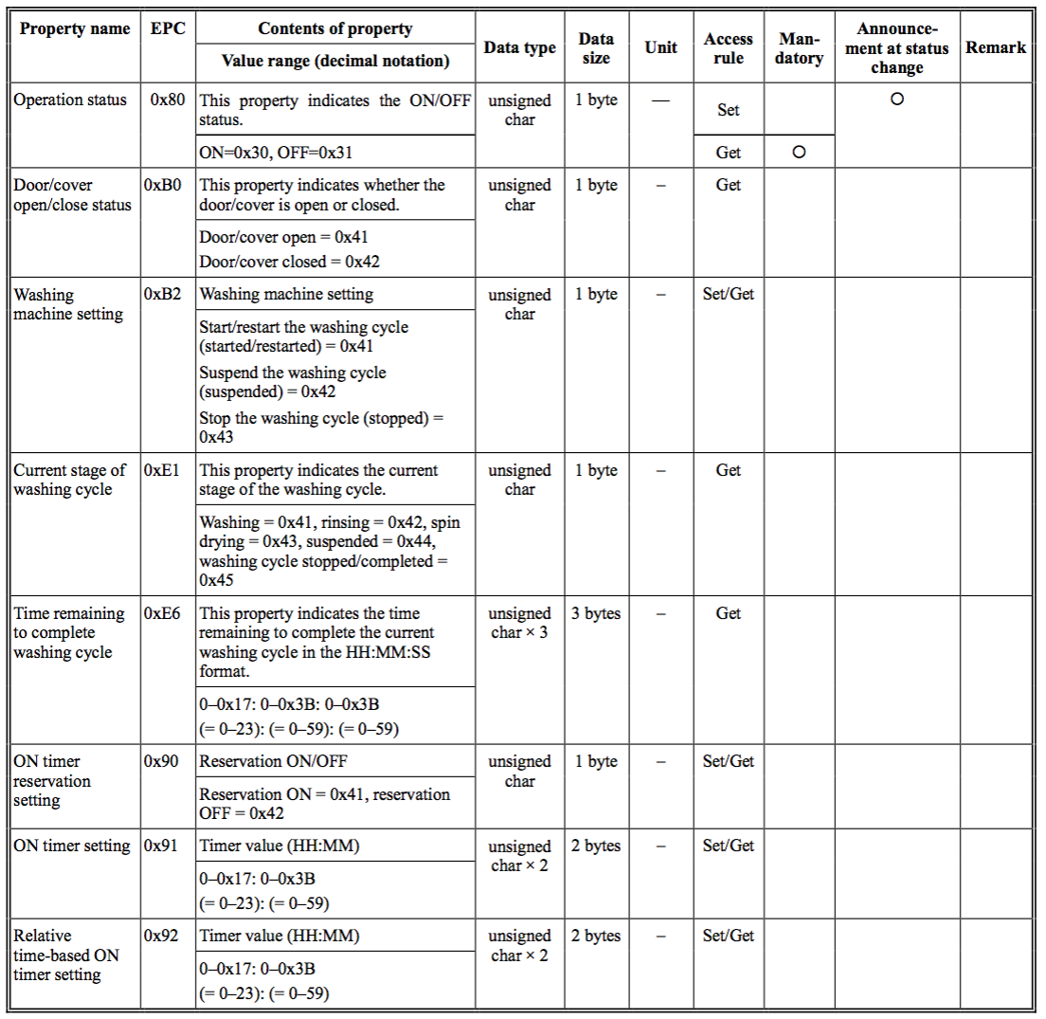
Echonet Washing Machine Source: http://www.echonet.gr.jp/english/spec/pdf_spec_app_e_e/SpecAppendixE_e.pdf

Slide 4
Translation to SDT (1/2)
Document
<Domain name=“jp.gr.echonet”>
<ModuleClass name=”WashingMachine">
<Data>
<DataPoint name=“operationStatus” type=“boolean” writable=“true”>
<Doc>
Indicates the ON/OFF status.
</Doc>
</DataPoint/>
<DataPoint name=“doorCoverOpenCloseStatus” type=“boolean”>
<Doc>
Indicates whether the door/cover is open or closed.
</Doc>
</DataPoint/>
<DataPoint name=“washingMachineSetting” type=“integer” writable=“true”>
<Doc>
Washing machine setting.
</Doc>
</DataPoint/>
<DataPoint name=“currentStageOfWashingCycle” type=“integer”>
<Doc>
Indicates the current stage of the washing cycle.
</Doc>
</DataPoint/>

Slide 5
Translation to SDT (2/2)
Document
<DataPoint name=“timeRemainingToCompleteWashingCycle” type=“time”>
<Doc>
Indicates the time remaining to complete the current washing cycle in
the HH:MM:SS format.
</Doc>
</DataPoint/>
<DataPoint name=“onTimerReservationSetting” type=“boolean” writable=“true”>
<Doc>
Reservation ON/OFF.
</Doc>
</DataPoint/>
<DataPoint name=“onTimerSetting” type=“time” writable=“true”>
<Doc>
Timer value (HH:MM).
</Doc>
</DataPoint/>
<DataPoint name=“relativeOnTimeBasedTimerSetting” type=“time” writable=“true”>
<Doc>
Timer value (HH:MM).
</Doc>
</DataPoint/>
</Data>
</ModuleClass>
</Domain>

Slide 6
Requested action
None

Slide 7
Thank You! Andreas.sayegh@telekom.de

